Slide 1
Model Evaluation
Receiver Operating Characteristic (ROC) Curves and Area Under the Curve (AUC)

Slide 2
Overview
Receiver Operating Characteristic (ROC) Curves
Precision Recall (PR) Curves
Comparing models using ROC AUC / PR AUC

Slide 3
Alternate Accuracy Measures
Actual Class
C₁
C₂
If “C₁” is the important class,
Sensitivity (also called “recall) = % of actual C₁ class correctly classified
n _{1, 1} / (n _{1, 1} + n _{1, 2})
True Positive Rate, TPR = TP/ (TP + FN)
Specificity = % of actual C₂ class correctly classified
n _{2, 2} / (n _{2, 1} + n _{2, 2})
True Negative Rate, TNR = TN / (FP + TN)
False Positive Rate (FPR) = 1- Specificity
FPR = FP / (FP + TN)
n _{1, 1} = number of C₁ records classified correctly as C₁
n _{2, 1} = number of C₂ records classified incorrectly as C₁
C₁
Predicted
Class
True Positive (TP)
False Positive (FP)
n _{1, 2} = number of C₁ records classified incorrectly as C₂
n _{2, 2} = number of C₂ records classified correctly as C₂
C₂
False Negative (FN)
True Negative (TN)

Slide 4
ROC Curves (Receiver Operating Characteristic Curves) for a Perfect Classifier
When threshold is near 1,
Sensitivity = TP/(TP+FN) = 0/10 = 0
Specificity = TN/(TN+FP) = 10/10= 1
Hence (0,0)
1.00
Threshold
Genuine Mail (10)
SPAM Mail (10)
(0,1)
(0.5,1)
(1,1)
1.00
Actual
0.80
Gen
SPAM
When threshold is near .75,
Sensitivity = TP/(TP+FN) = 5/10 = 0.5
Specificity = TN/(TN+FP) = 10/10= 1
Hence (0,0.5)
Gen
TP=0
FP=0
Pred
SPAM
FN=10
TN=10
0.75
Actual
SPAM
0.60
Gen
Gen
TP=5
FP=0
Pred
Sensitivity (TPR)
When threshold is near 0.5,
Sensitivity = TP/(TP+FN) = 10/10 = 1
Specificity = TN/(TN+FP) = 10/10= 1
Hence (0,1)
SPAM
FN= 5
TN=10
(0,0.5)
0.50
Actual
0.40
Gen
SPAM
Gen
TP=10
FP=0
Pred
SPAM
FN=0
TN=10
When threshold is near 0.25,
Sensitivity = TP/(TP+FN) = 10/10 = 1
Specificity = TN/(TN+FP) = 5/ 10 = 0.5
Hence (0.5,1)
0.25
Actual
0.20
Gen
SPAM
Gen
TP= 10
FP=5
Pred
SPAM
FN= 0
TN=5
(0,0)
0.00
Actual
SPAM
0.00
When threshold is near 0.0,
Sensitivity = TP/(TP+FN) = 10/10 = 1
Specificity = TN/(TN+FP)= 0/10 = 0
Hence (1,1)
Gen
Gen
TP = 10
FP = 10
0.20
0.40
0.60
0.80
1.00
Pred
SPAM
FN= 0
TN= 0
1 – Specificity (FPR)

Slide 5
ROC Curves (Receiver Operating Characteristic Curves) for a Perfect Classifier
ROC curve is an evaluation metric for binary classification problems.
Plots the Sensitivity (TPR) against 1 – Specificity (FPR) for varying threshold values
Area Under the Curve (AUC) is the measure of the ability of a classifier to distinguish between classes and is used as a summary of the ROC curve
The goal in ROC space is to be in the upper-left-hand corner (0, 1), i.e. zero FP’s (FPR=0) ; Sensitivity(Recall)=1, i.e. all the positives classified as positives
The diagonal (the “curve” for a naïve classifier), on an average, when drawing randomly scores on the unit interval or if our predictions are all 0 or all 1.
1.00
Threshold
Genuine Mail (10)
SPAM Mail (10)
(0,1)
(0.5,1)
(1,1)
1.00
0.80
0.75
0.60
Sensitivity (TPR)
(0,0.5)
0.50
0.40
0.25
0.20
(0,0)
0.00
0.00
0.20
0.40
0.60
0.80
1.00
1 – Specificity (FPR)

Slide 6
Precision Recall Curves for a Perfect Classifier
Performance of the positive class (minority) when dealing with imbalanced classes.
We are less interested in the skill of the model at predicting class 0 correctly, e.g. high true negatives. Key to the calculation of precision and recall is that the calculations do not make use of the true negatives. It is only concerned with the correct prediction of the minority class
In the PR space, the goal is to be in the upper-right-hand corner — the top right corner (1, 1), all positives are classified as positive (Recall=1) and everything we are classifying as positive is true positive (Precision=1), ie zero False Positives.
1.00
Threshold
Genuine Mail (10)
SPAM Mail (10)
(0,1)
(0.5,1)
(1,1)
1.00
0.80
0.75
0.60
Precision
(0,0.5)
0.50
0.40
‘No Model’ Baseline obtained by P/(P+N), where the classifier always predicts the minority class, i.e. positive.
0.25
0.20
(0,0)
0.00
0.00
0.20
0.40
0.60
0.80
1.00
Recall (Sensitivity)

Slide 7
ROC Curve for Imperfect classifier
By design the ROC curve typically develops in a U-shape
Step Left: Turn a False Positive (blue cross) into a True Negative (blue dot). This behavior represents a correct decision and thus it reduces the False Positive Rate (x-axis) (mostly from -1.5 to -0.5)
Step downwards: Turn a True Positive (orange dot) into a False Negative (orange cross). This behavior represents a wrong decision and thus it reduces the Recall (y-axis). (mostly from 0.5 to 1.5)
Image Source: https://towardsdatascience.com/on-roc-and-precision-recall-curves-c23e9b63820c

Slide 8
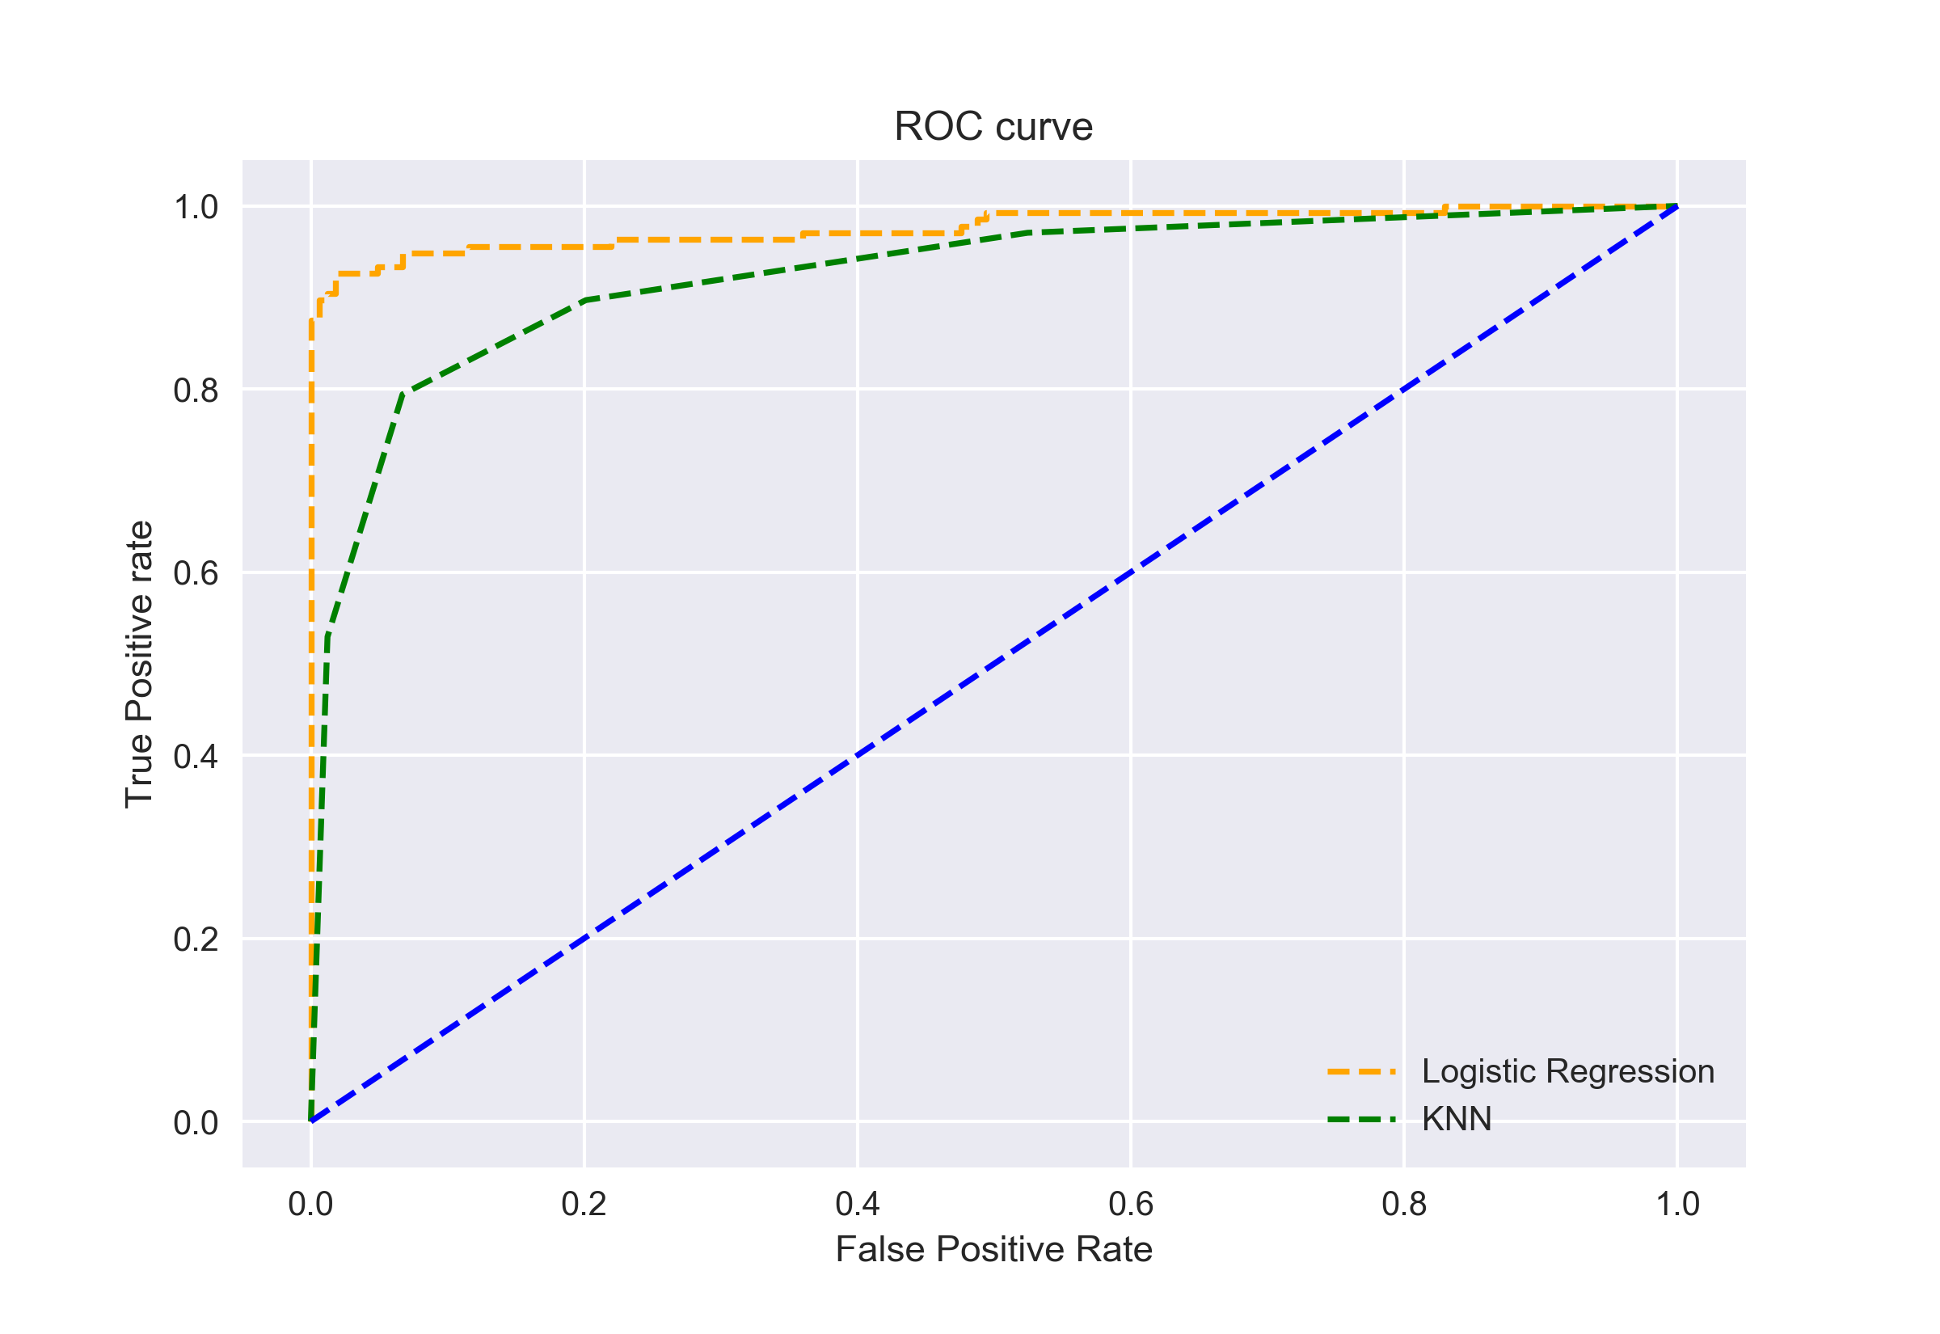
ROC curves for comparing models – Area Under the Curve
The curves of different models can be compared directly in general or for different thresholds.
As it can be challenging to compare two or more classifiers based on their curves, the Area Under the Curve (AUC) can be used as a summary of the model skill
AUC for the Logistic Regression ROC curve is higher than that for the KNN ROC curve.
Here Logistic regression performs better in classifying the positive class in this dataset
PR AUC can be used for compare classification models on imbalanced datasets
Image Source: https://www.analyticsvidhya.com/blog/2020/06/auc-roc-curve-machine-learning/

Slide 9
Summary
ROC curve is an evaluation metric for binary classification problems.
ROC plots the Sensitivity (TPR) against 1 – Specificity (FPR) for varying threshold values
The goal in ROC space is to be in the upper-left-hand corner
ROC AUC used to compare across different classification models
PR Curve is used to assess the performance of the model on positive class (minority) when dealing with imbalanced classes.
PR AUC used to compare classification models on imbalanced datasets

Slide 10
References
https://www.analyticsvidhya.com/blog/2020/06/auc-roc-curve-machine-learning/
https://towardsdatascience.com/on-roc-and-precision-recall-curves-c23e9b63820c
https://machinelearningmastery.com/roc-curves-and-precision-recall-curves-for-classification-in-python/
https://machinelearningmastery.com/roc-curves-and-precision-recall-curves-for-imbalanced-classification/

